Slide 1

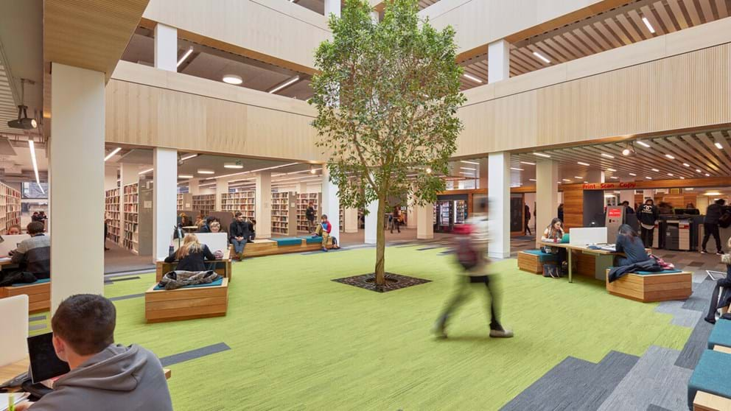
Literature Searching for your Final Year Project
Bob Frost – Faculty Librarian

Slide 2
What is a Background Section?
An evaluation of published information in a discrete area of research. It describes, summarises and critically reviews the available evidence within a theoretical framework.
It identifies what is known but also where there are knowledge gaps.
It will give you ideas and stop you making mistakes.

Slide 3
What is the purpose of a background section?
To provide a context and justification for your research
To identify similar projects/ problems/ themes/ methodology/ evaluation methods and critically explore how these are relevant to your research
Highlight any limitations in previous research
Highlight any gaps in the body of research
To show where your research fits into the existing literature

Slide 4
How do I structure the background section?
You can organise…
Funnel model
Thematically
Methodologically
Chronologically
Notes:
At the end of last week’s workshop, we asked you to go away and look back on the background section of your 3rd year project, reflecting on how you used the literature, so I’m going to start by looking at the structure of this section, and you may find it useful after this session to look at the structure of last years report and identify how it could be improved.
As I said, it’s not just a description of the studies you’ve come across in your literature search. Often I see literature reviews that read like a bullet pointed list – Smith said, Jones stated that, Wilson defines etc.
One of the most common approaches is a thematic structure, where you group research into key themes, so for Katherine’s review she has identified 5 themes including display blindness, interaction blindness etc.
If you go for a chronological approach you may want to group together and discuss sources according to when they were published, which can be useful if you want to highlight changes & developments in research field over time.
If you structure methodologically you may want to focus on the different methods used to study the topic.
You may find it useful to look at other literature reviews/ background sections in journal articles to see how they have been structured.

Slide 5
YOUR QUESTION:
Complementary Datasets in Federated Learning
Constraints/requirements Q-learning/deep-learning; strong mathematic skills
Description
Machine learning is a data-driven technology. The features of the datasets heavily influence the outcome of the machine
learning algorithms. This project includes dataset manipulation, the machine learning algorithm deployment, and the federated learning architecture. You will be analysing the learning accuracy and resource consumption of
the federated learning framework regarding different correlation factors of datasets.
Reading
• https://en.wikipedia.org/wiki/Federated_learning

Slide 6
IDENTIFYING KEYWORDS FOR SEARCHING:
CAST YOUR NET AS WIDE AS YOU CAN BY USING SYNONYMS
“federated learn*” OR “distributed learn*” OR “collaborative learn*”
AND
data*
AND
manipulat*

Slide 7
SEARCHING TIPS AND TRICKS:
Truncation *
data*
finds: data, dataset, datasets etc.
Phrase searching “”
“federated learning” finds that exact phrase
Spelling and plural variations ?
behavio?r finds behaviour + behavior

Slide 8
WHERE TO SEARCH:
OneSearch ebooks/articles
Scopus articles/conference proceedings
Web of Science
Leipzig Library Guide contains all relevant LU library links.
LinkedINLearning Python, SQL, Azure, R, SPSS, DevOPS and so much more!

Slide 9
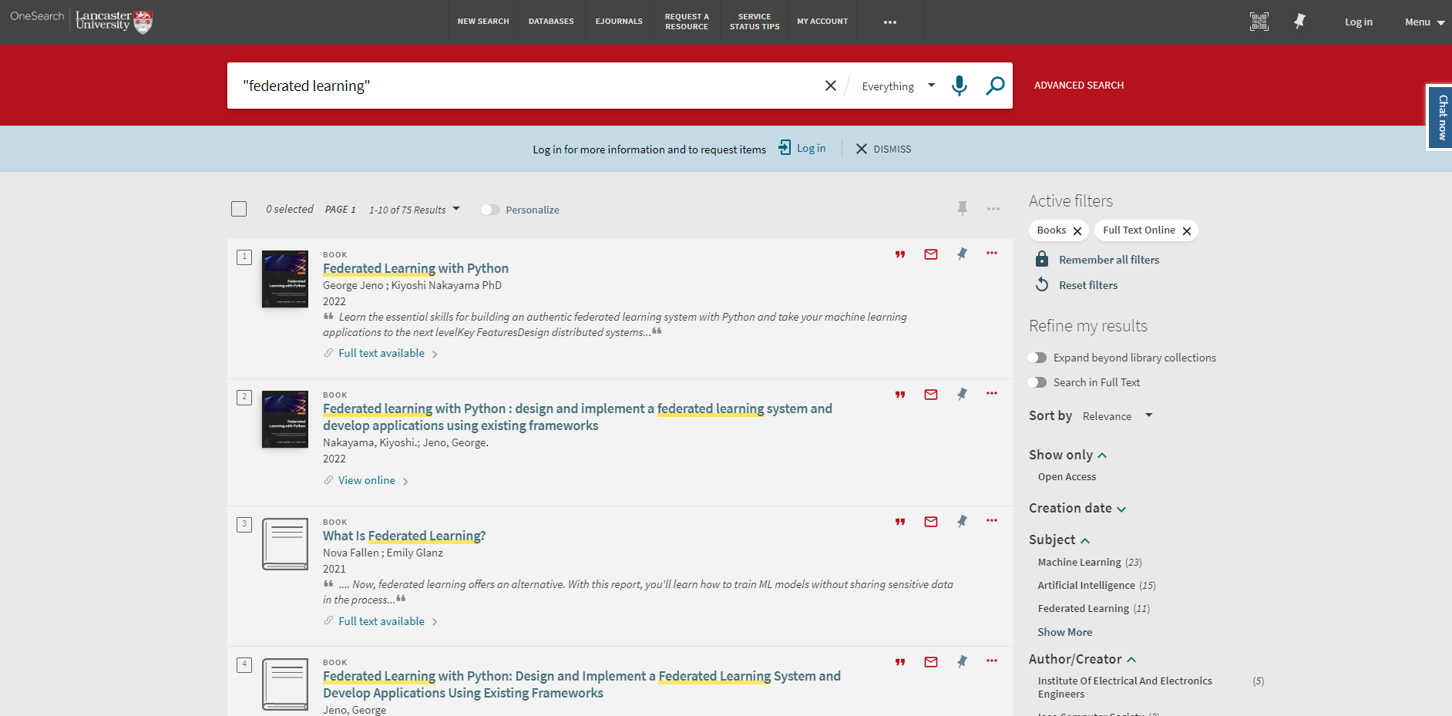
WHERE TO SEARCH:

Slide 10
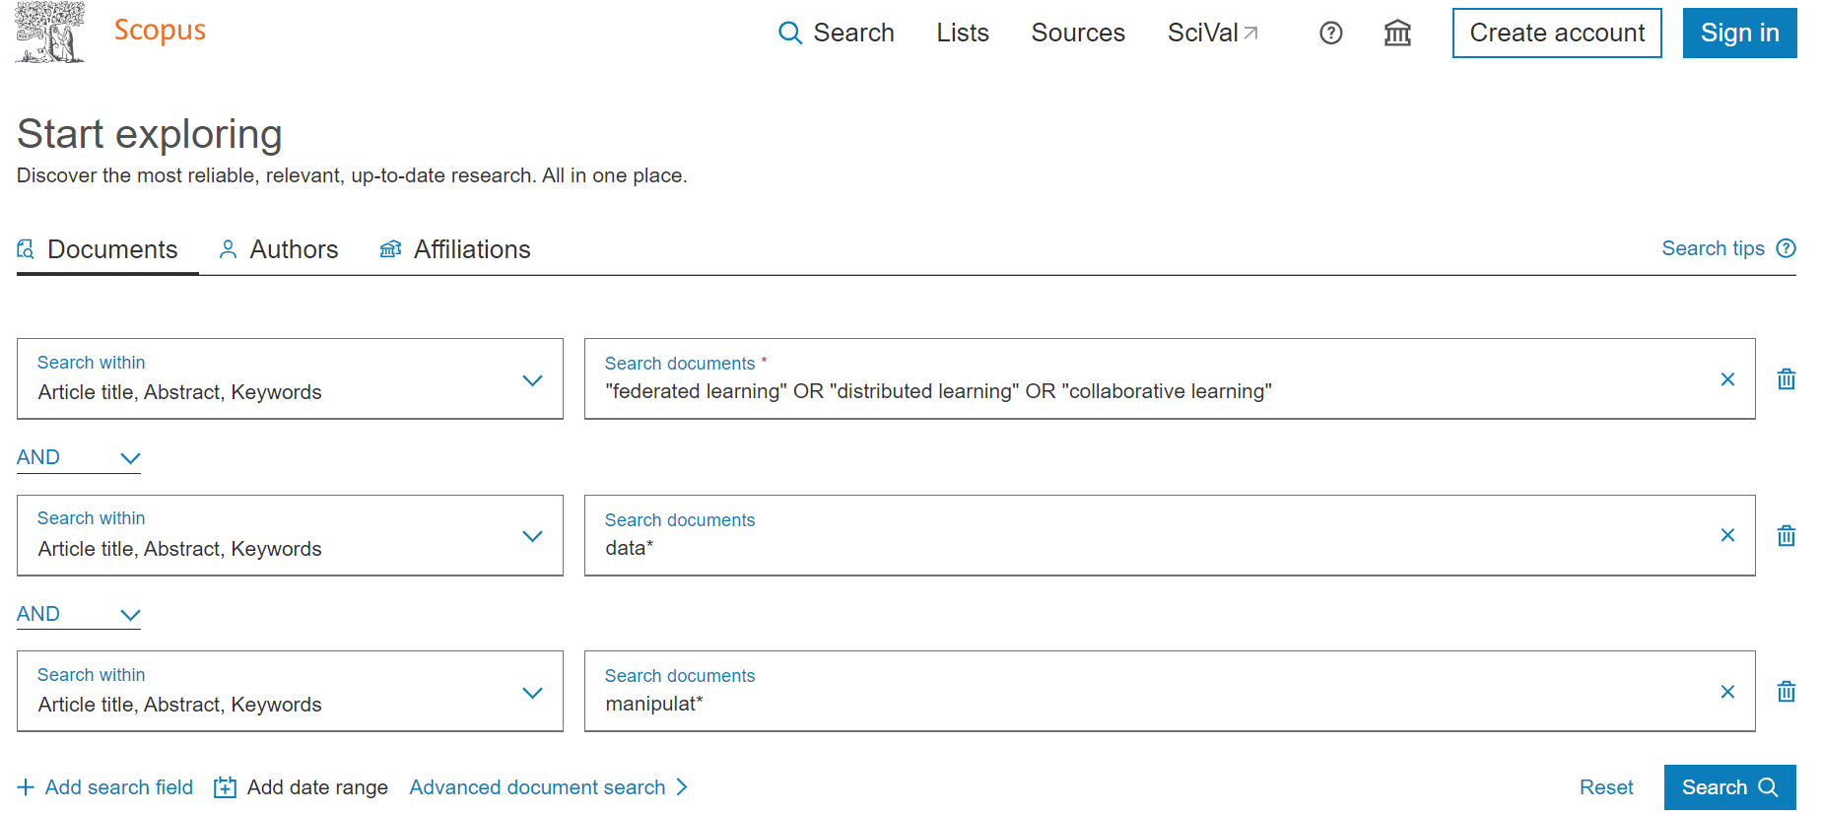
EXAMPLE OF A SCOPUS SEARCH:

Slide 11
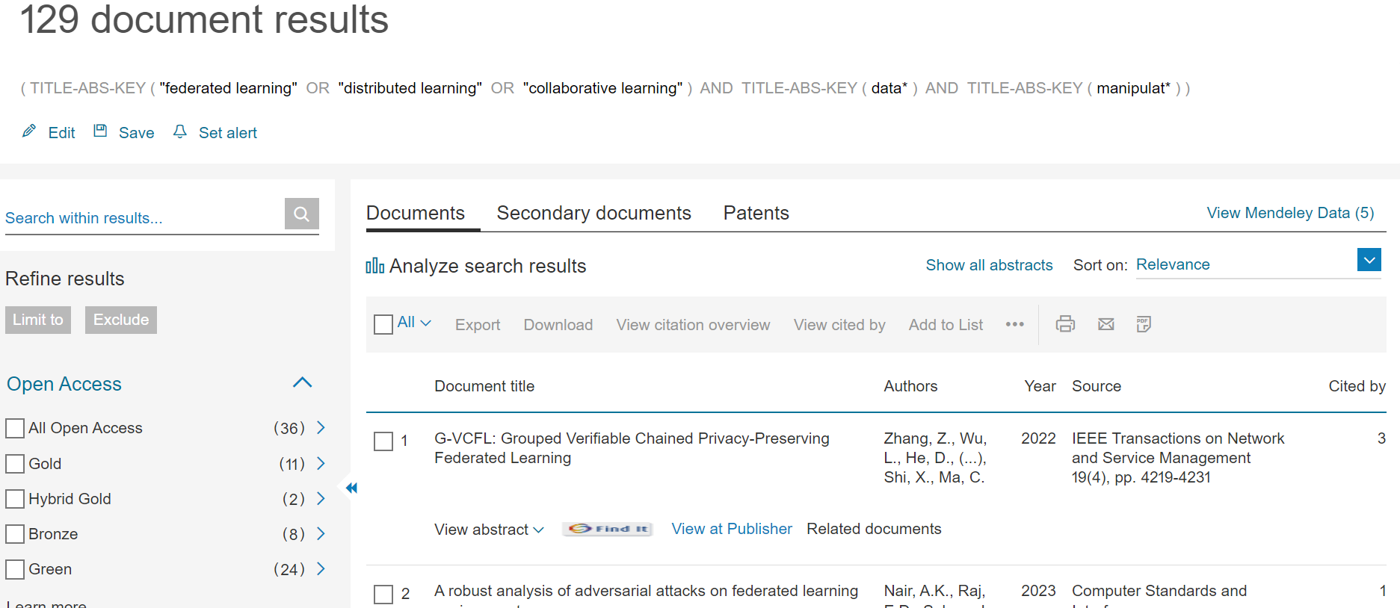
SCOPUS RESULTS PAGE:

Slide 12

EXAMPLE OF A STATISTA REPORT:

Slide 13
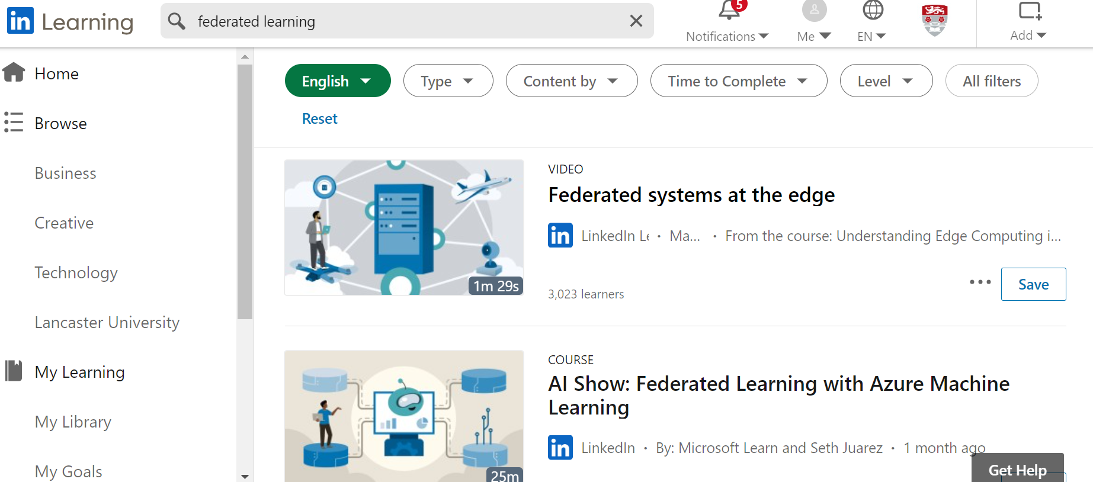
LinkedinLearning – Federated Learning/Q Learning videos

Slide 14
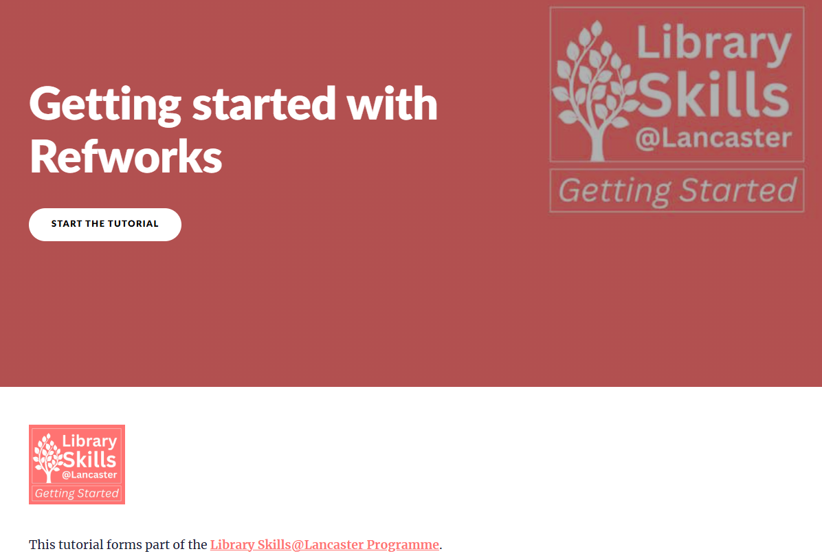
Reference Management Software: Refworks for MS Word

Slide 15
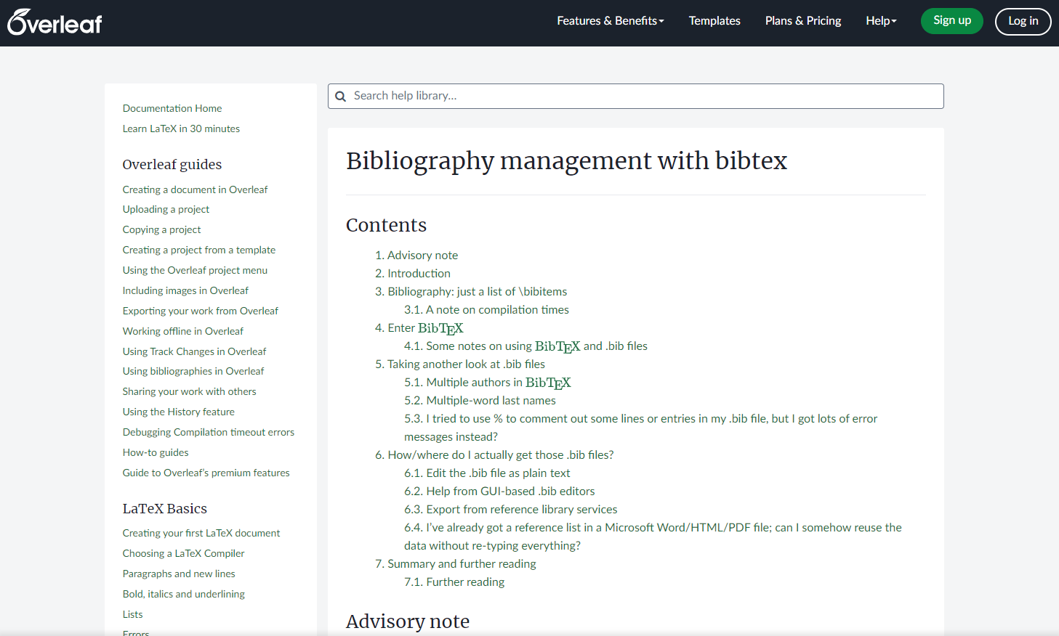
Reference Management Software: LaTex
Overleaf Lancaster

Slide 16
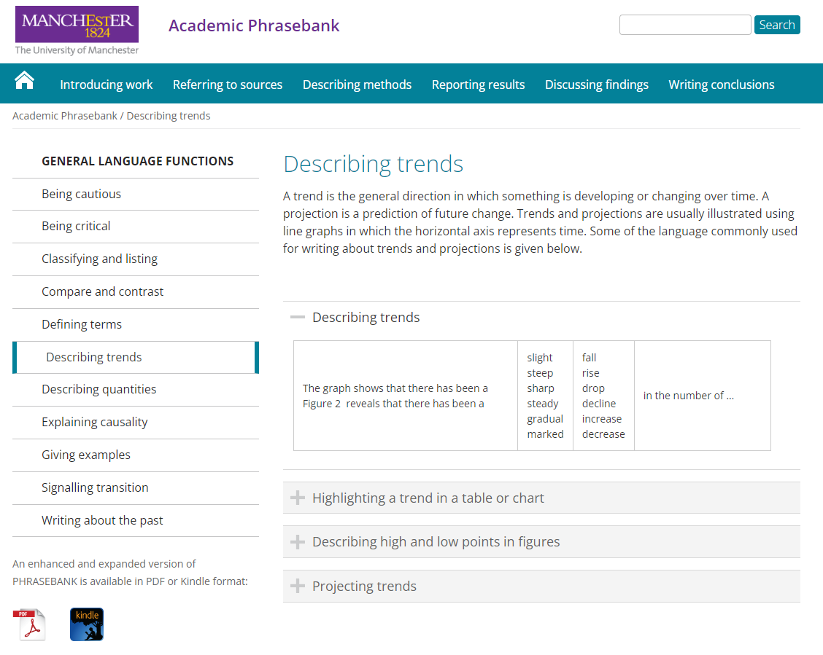
Academic Phrasebank:
It aims to provide you with examples of some of the phraseological ‘nuts and bolts’ of writing organised according to the main sections of a research paper or dissertation.

Slide 17

Help & support:
Faculty Librarian – Bob Frost r.frost6@lancaster.ac.uk
Bob’s aim is to support students in maximising their use of our Library resources.
Book an appointment:
FST | Lancaster University

